Slide 1
California Early
Voting Locations
California Love
Claire Huang, Fernando Melchor,
Adriano Yoshino, Tyler Woebkenberg

Slide 2
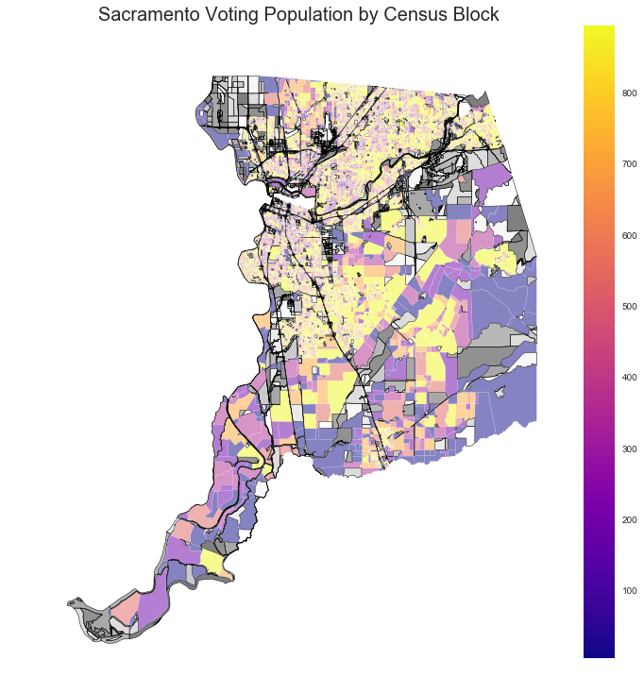
Early Voting Locations
Identifying optimal locations for early voting sites as indicated by California Senate Bill 450

Slide 3
Process
Review of SB450 Regulations
Data Collection, Cleansing, and Joining
Census
American Community Survey
LODES (Longitudinal Employer-Household Dynamics)
Analysis
Mapping

Slide 4
SB450 Regulations & Stats
Early Voting Locations
10-4 Days before Election
4-0 Days before Election
Ballot Drop-off Locations
28-0 Days before Election
Sacramento Population - 1,465,832
Eligible Voting Population - 1,105,088
Number of 10-4 Early Voting Locations - ~22
Number of 4-0 Early Voting Locations - ~110
Number of Ballot Drop-off Locations - ~74

Slide 5
Analysis Methodology
Census Tract Identification
Partitioning - Community Detection
Density Cluster - DBScan
Census Block Identification
Eligible Voting Population Density

Slide 6
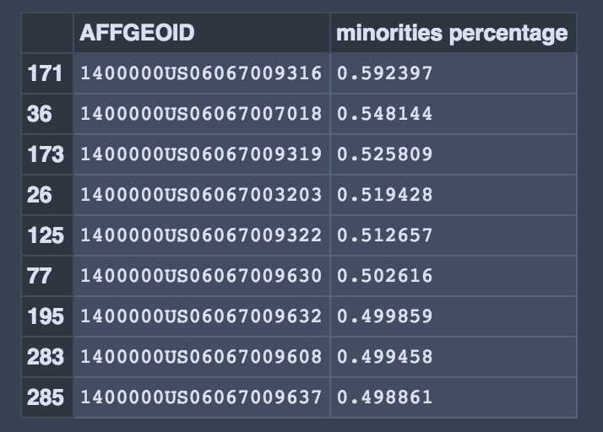
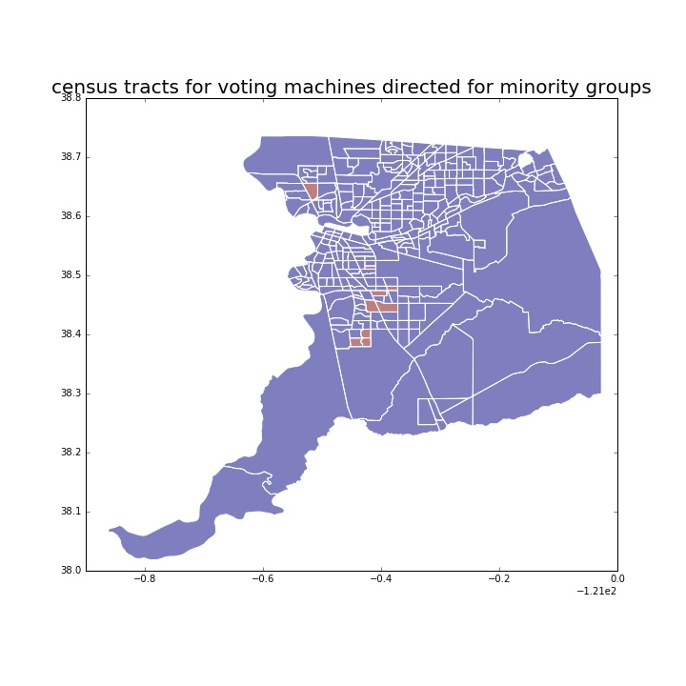
Output

Slide 7
Challenges & Future Thoughts
Challenges
More detailed Population and Attribute data (Census Block level)
Proper analysis for Census Tract identification
Future Thoughts
Expand to incorporate additional attributes - Transportation, Parking, Travel Times, Traffic, Public Transportation & Access
Build into a repeatable process and app

